Slide 1
BT233 – General Microbiology Laboratory
Differential Staining
Gram Staining
Week#4

Slide 2
Classification of bacteria
The first step in classification of bacteria is differentiation
between: Gram positive, Gram negative, and acid – Fast bacteria
For further classification, there is a special key for each of the
above bacterial group that differ from the other group.
You must be sure about your first classification in order to
achieved the correct bacterial classification.

Slide 3
How we are Sure about our classification of bacteria into Gram positive and Gram negative?!!!
This is by using the following three methods:
1. Using of Selective media
2. Using of 10% KOH
3. Using of Gram-Staining

Slide 4
1.Using Selective Media
Example: EMB (Eosin Methylene Blue media), TSI (Triple Sugar
Iron agar, MacConkey agar, Bismuth sulfite agar
All of these media are selective for Gram negative bacteria, the
Gram positive can’t grow on this media
Question: If We have unknown bacterium, After inoculation
and incubation on these media if the bacteria
* Grew: the bacteria is 95% Gram negative
* Not grew: the bacteria is Gram positive

Slide 5
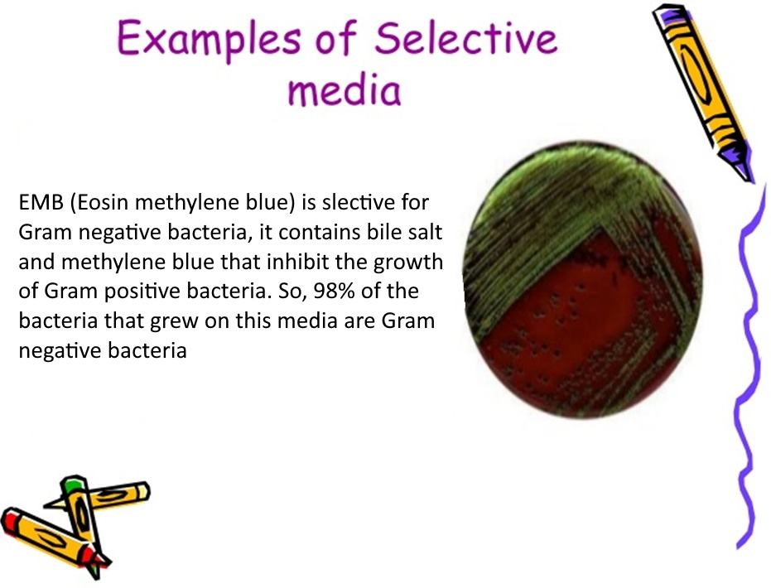

Slide 6
2. Using of 10% KOH
According to the main composition the bacterial cell wall divide into:
A. The cell wall that mainly composed from peptidoglycan
The cell wall of Gram-positive bacteria
B. The cell wall that mainly composed from Lipopolysaccharide
The cell wall of Gram-negative bacteria
B. The cell wall that composed from Mycolic Acid
The cell wall of bacteria which we considered it as Gram-positive
bacteria ( Acid-Fast bacteria).

Slide 7
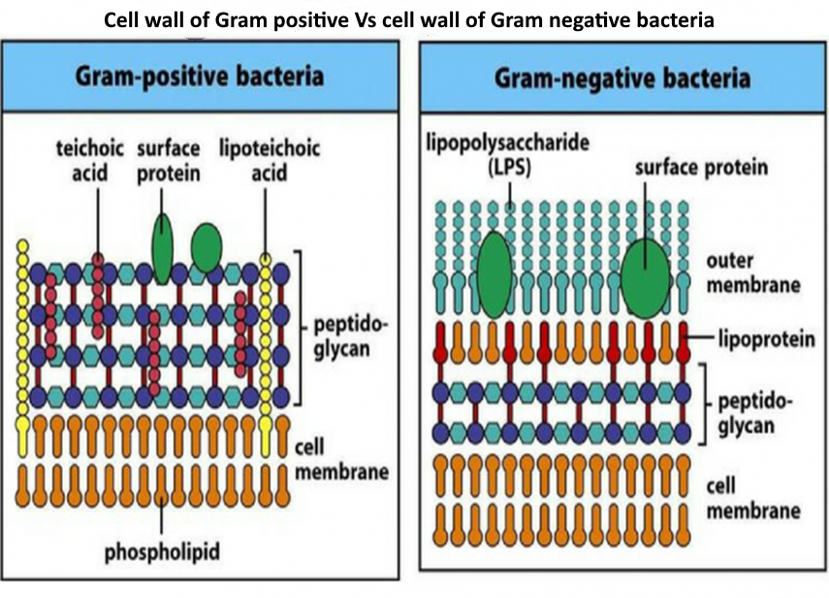

Slide 8
The principle of 10% KOH test
10% KOH dissolves Lipopolysaccharide neither
Peptidoglycan nor Mycolic Acid.
Saturated mixture of Lipopolysaccharide is
viscous (mucoid)
This method differentiate Gram-negative from
from others ( can’t differentiate between gram-
positive and considered as Gram-positive

Slide 9
Materials
1. Slides
2. Loop
3.Bacteria G+ (Bacillus) and G- (E coli)
4.10% KOH

Slide 10
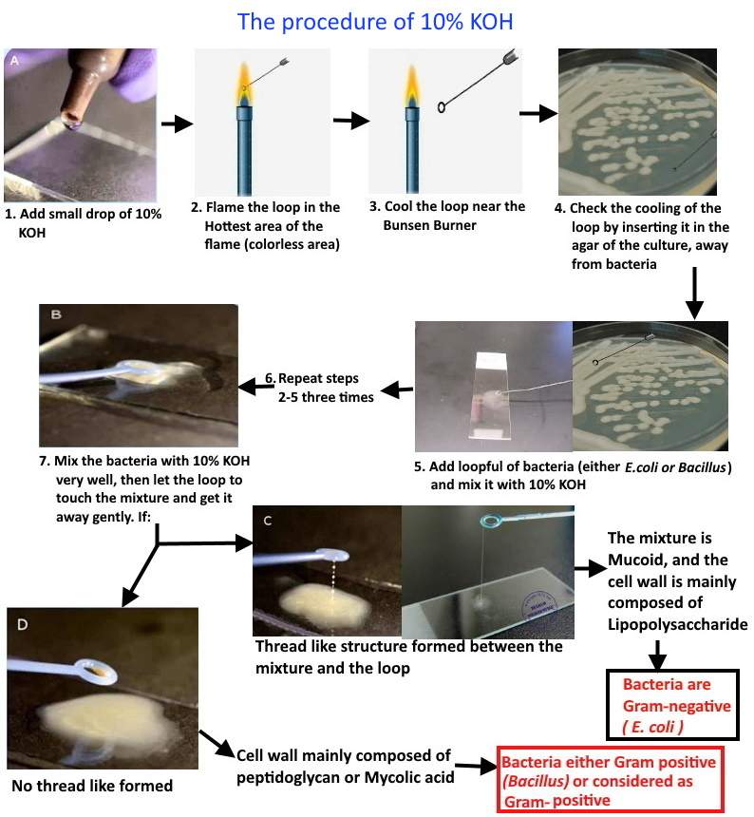

Slide 11
3. Using Gram Staining
Gram staining is used to classify the bacteria into three
large groups:
Gram positive (+ve)
Gram negative (-ve)
Considered as Gram positive

Slide 12
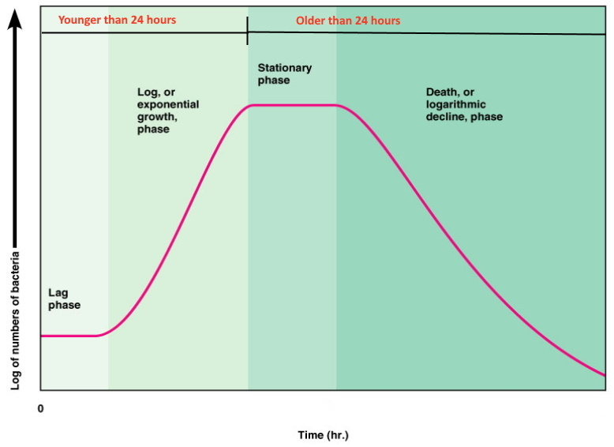
3. Using Gram Staining
The bacteria to be stained
through Gram staining it
must be not older than
24 hours
For motile bacteria the
center of the colonies
is fresher than the edge
of it

Slide 13
Material needs for Gram Staining
6. Crystal violet or Methylene
blue stains
7. Iodine
8. Safranin
9. Ethanol 95% or Absolute 100%
10. Compound Microscope
1. Bacterial culture (E. coli
and Bacillus)
2. Slides
3. Sterile distilled water
4. Filter paper
5. Loop

Slide 14
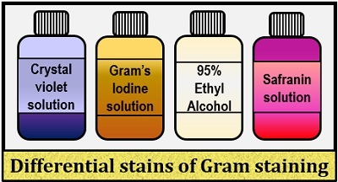

Slide 15
The Procedure of Gram Staining
Smear preparation: we need to prepare three complete smears
up to the end of heat fixation, these smears are:
Smear for Bacillus
Smear for E. coli
The third smear is a mixed smear of Bacillus and E. coli

Slide 16
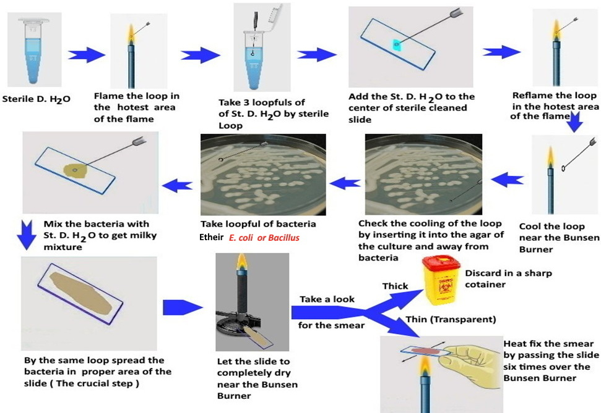
Smear preparation (Bacillus or E. coli smear)

Slide 17
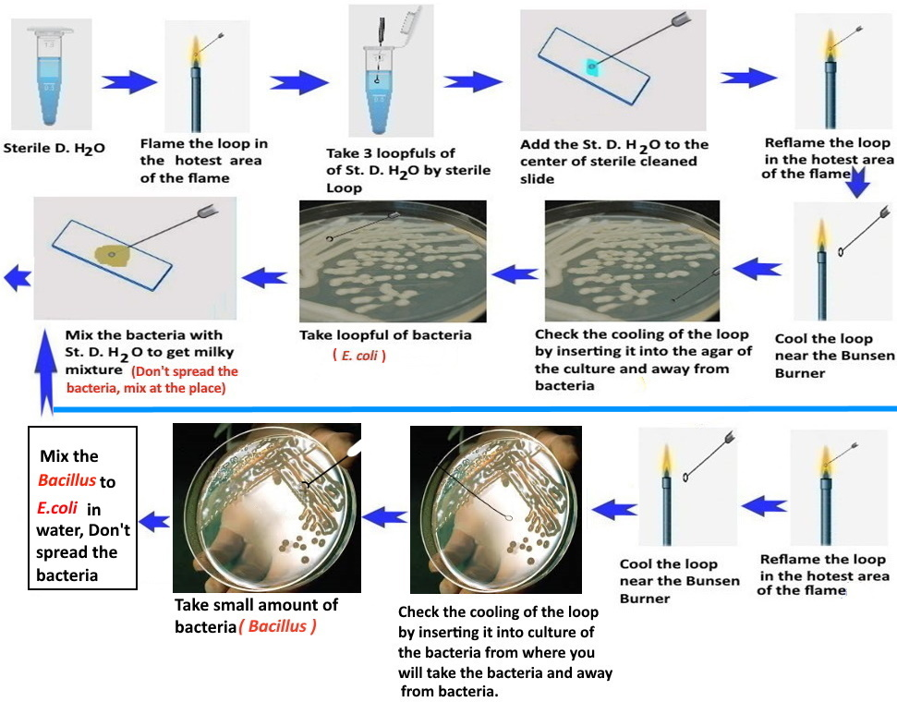
Smear preparation of mixed bacteria E. coli and Bacillus

Slide 18
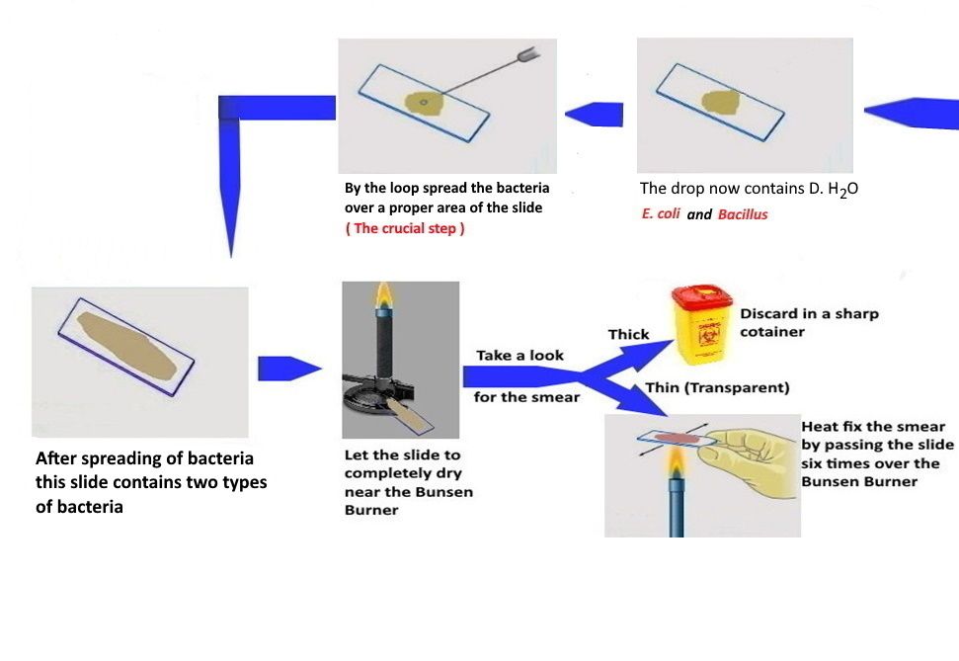
Follow Smear preparation of mixed bacteria E. coli and Bacillus

Slide 19

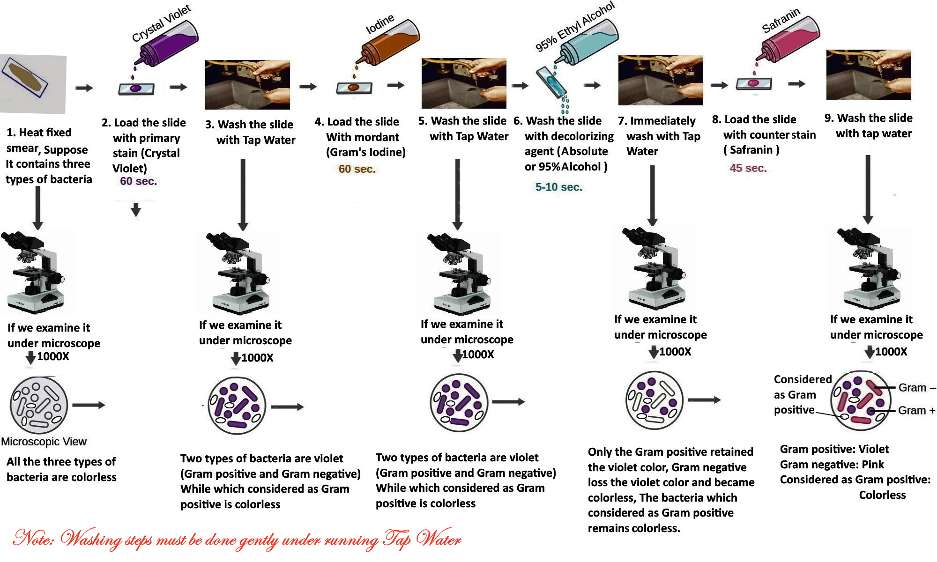

Slide 20
Principle of Gram Staining
For staining of bacteria, we depend on:
The charge of the bacteria
The charge of the stains
The permeability of bacterial cell wall for the stains
Peptidoglycan and Lipopolysaccharides cell walls are stains permeable
Mycolic acid cell wall ( Waxy lipoidal material ) is stains impermeable
The structure of the bacterial cell wall
We must consider all of these to understand the principle of Gram staining

Slide 21
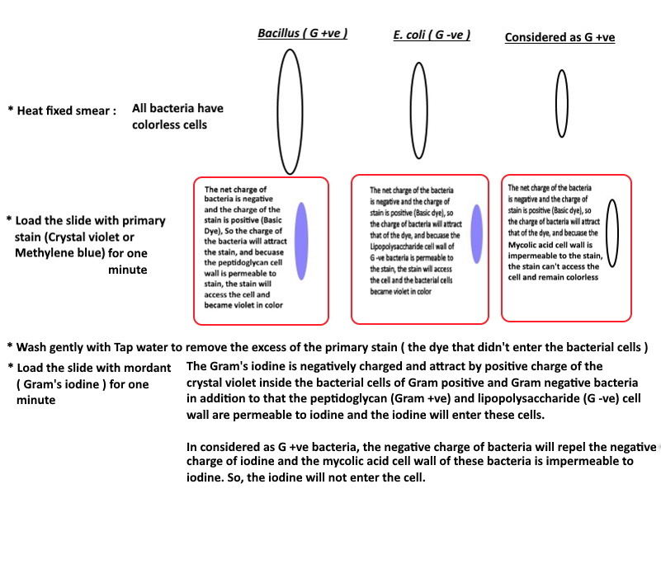
What happened in each step of Gram staining

Slide 22
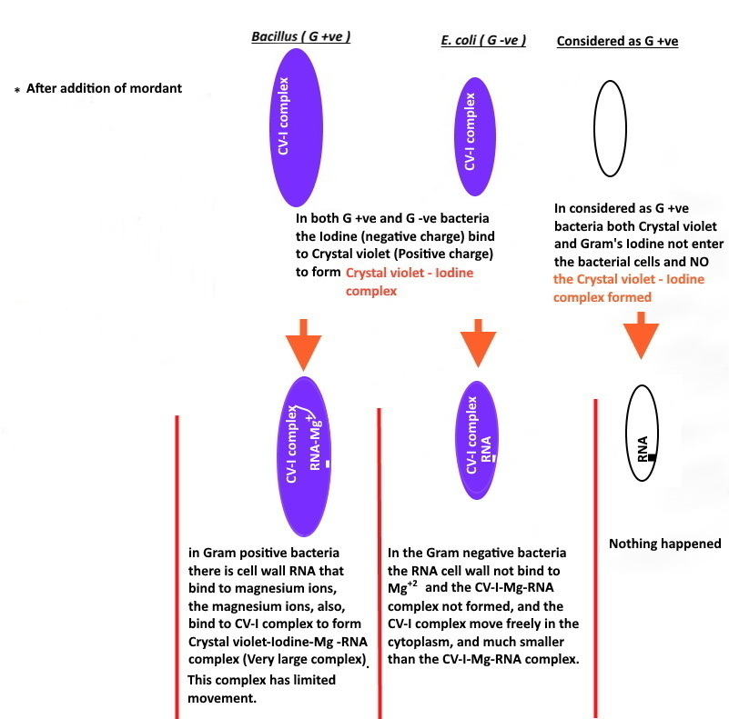

Slide 23
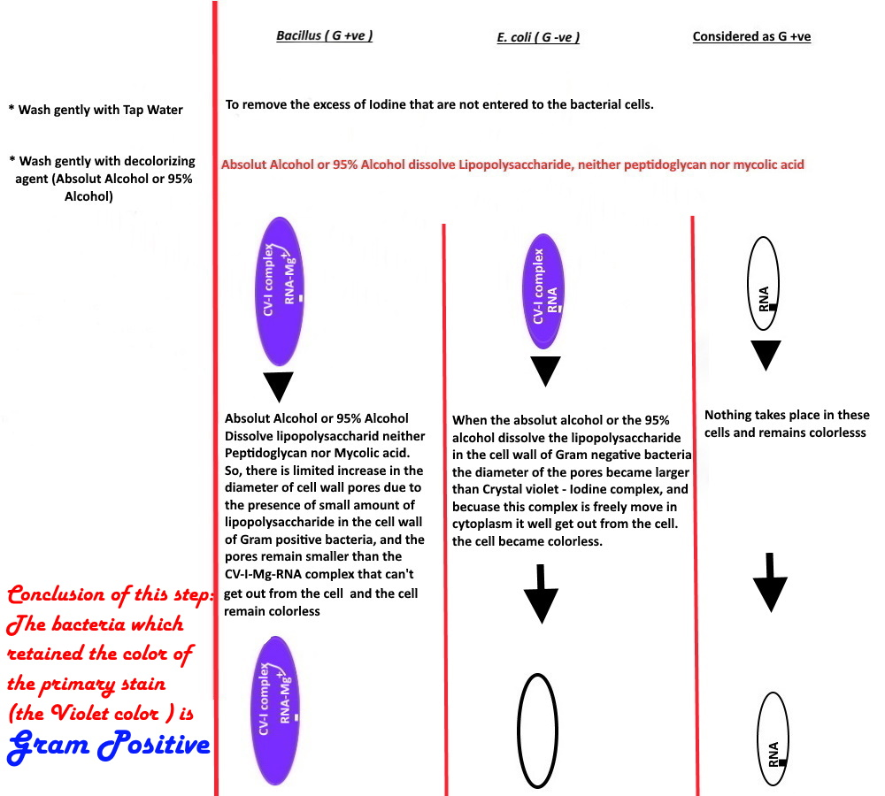

Slide 24
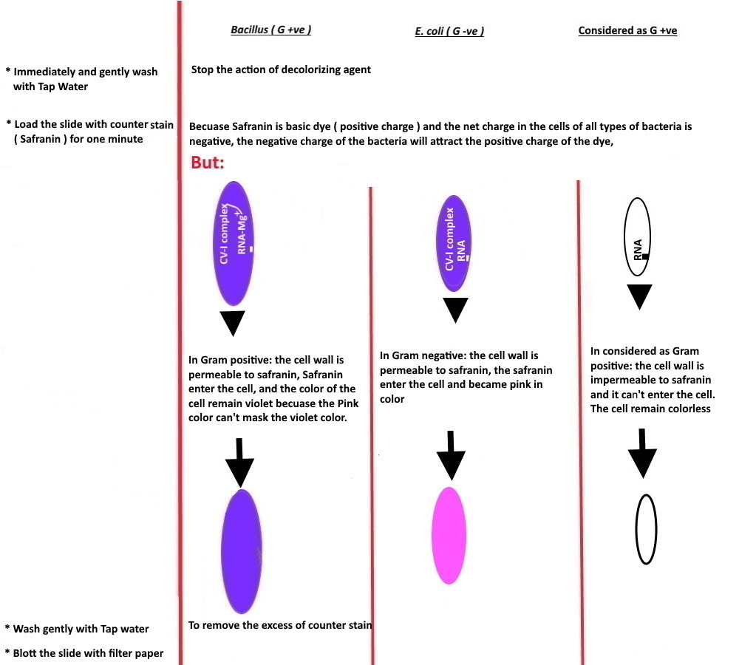

Slide 25
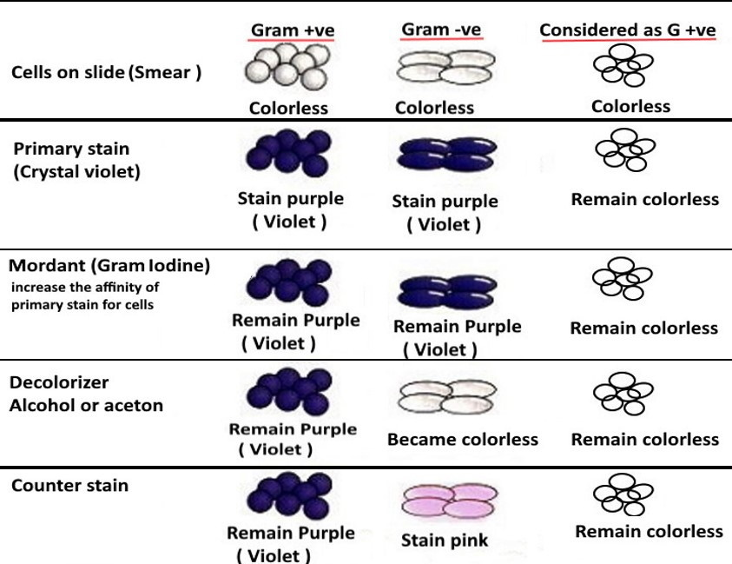

Slide 26
Conclusion
Gram staining divide the bacteria into:
Gram positive: The bacteria that retain the color of primary stain ( Violet )
Gram negative: The bacteria which accept the color of counter stain ( Pink )
Considered as Gram positive: The bacteria that remain colorless at the end
of Gram staining ( Can’t stain through Gram staining )
Gram staining determine the shape of bacterial cells: Bacilli, Cocci, Spirilli
Coccobacilli, and Vibrio
Gram staining determine the arrangement of bacterial cells

Slide 27
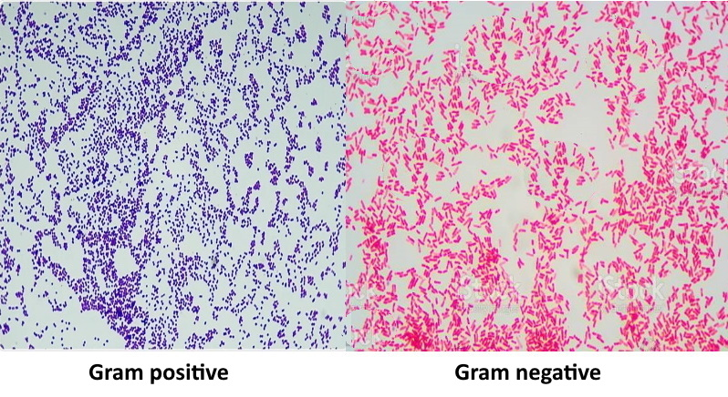

Slide 28
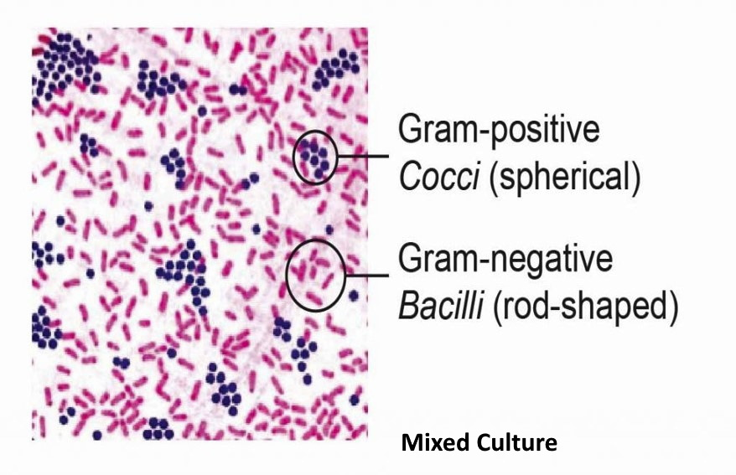

Slide 29
Important Question
Q) If we do gram stain for acid –fast bacteria. What is the color
will be?
Answer: The color of acid-fast bacteria (considered as G+) will be
colorless
Why?
Acid-Fast bacterial cell wall mainly composed of Mycolic acid which prevents stain entry to bacteria, so it needs a special protocol for staining.

Slide 30
Troubleshooting
If we switch primary stain and counterstain. For example, If we use Safranin as primary stain and Crystal violet as a counterstain, What will happen?
ANSWER:
In the last step, addition of counterstain ( Crystal violet ), it will enter both Gram positive and Gram negative. In:
Gram negative: this bacteria became colorless after decolorizing step and
when crystal violet added it became violet
Gram positive: this bacteria retain the color of primary stain, this mean the
color of safranin ( Pink ), and when the Crystal violet adds as a counterstain
it will enter the cell and mask the pink color, the bacteria became violet.
So, we can’t differentiate between Gram positive and Gram negative
The following slide shows what happened

Slide 31
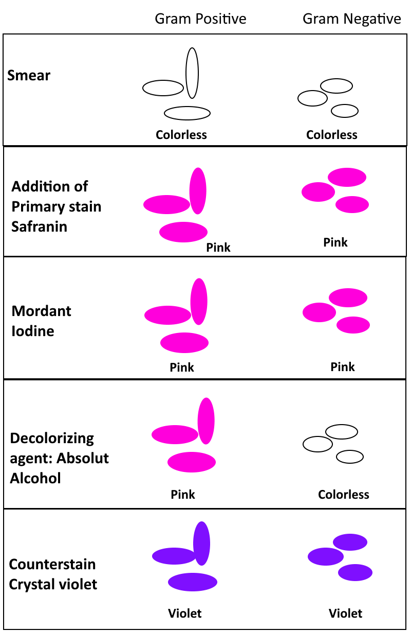

Slide 32
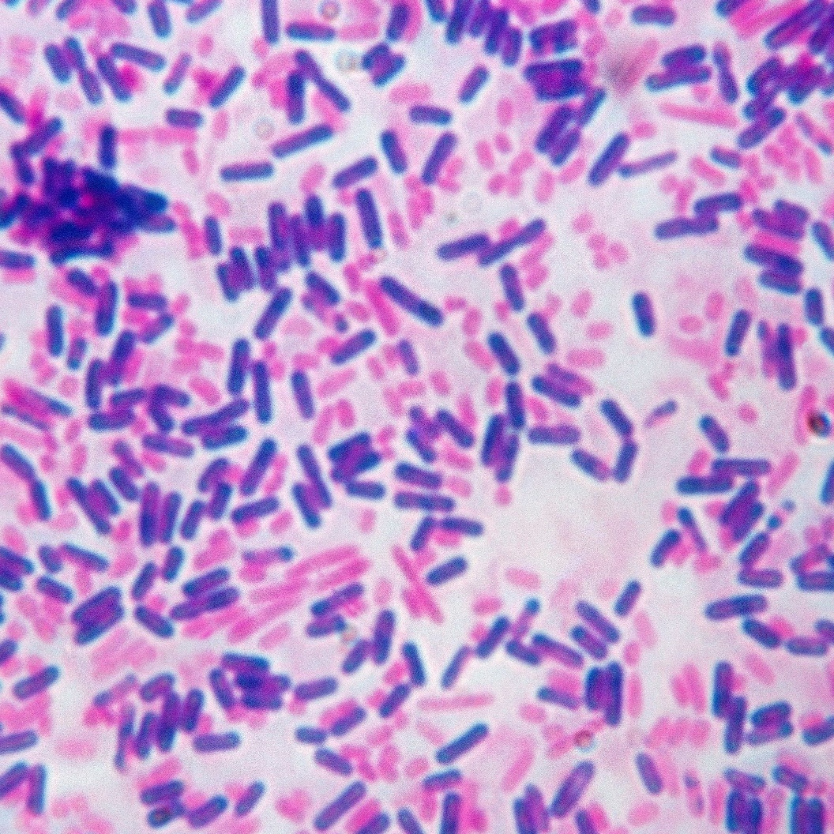
- If we do Gram staining to a pure culture: * Why we get the following field? The culture is older than 24 hour * What the correct Gram reaction of this bacteria? The bacteria is Gram positive

Slide 33
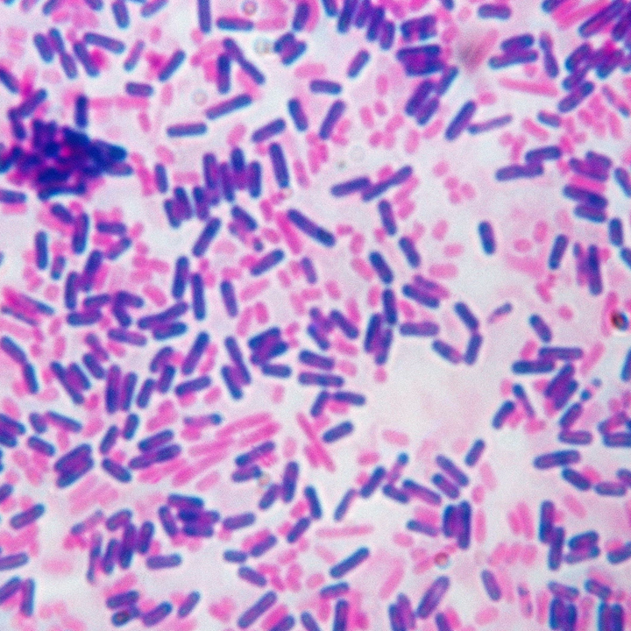
* What is the stage for the bacteria that stain Pink?
It is in stationary or decline phase * What is the stage for the bacteria that stain Violet?
It is in lag or log phase

Slide 34
Why we need fresh culture for Gram Staining(less than 24 hour old)?
Because if the bacteria is older than 24 hour:
The cell wall of bacteria became fragile.
The cell wall will break down by any environmental factor
mixing or heat, the remaining is protoplast the cell
without cell wall that accept the final stain which we add (Safranin in Gram staining).
So, the Gram positive bacteria tend to be Gram negative.

Slide 35
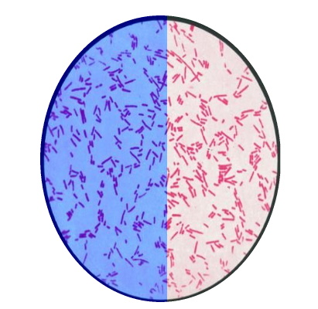
If we do Gram staining for pure culture and get the following result (picture), Answer the following questions: What is the Gram reaction of this bacteria? Why appear like this?

Slide 36
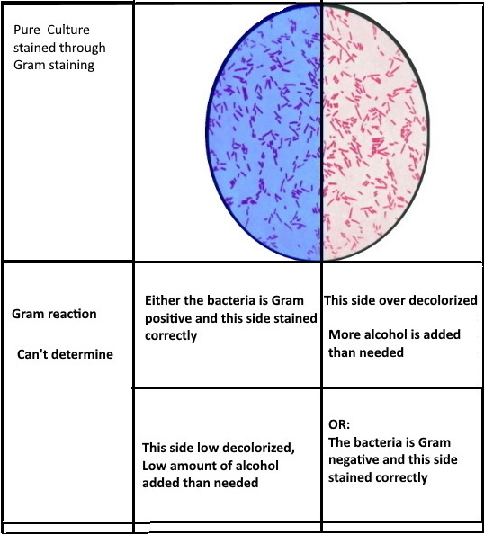

Slide 37
The End

